Slide 1
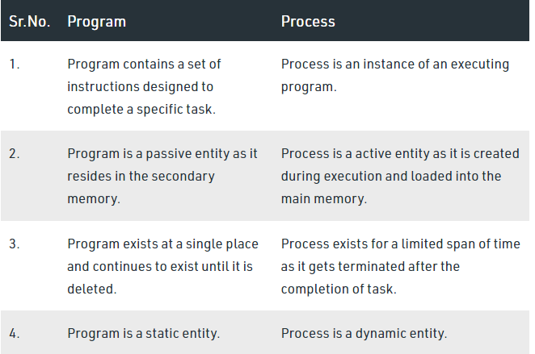
Difference between Program and Process

Slide 2
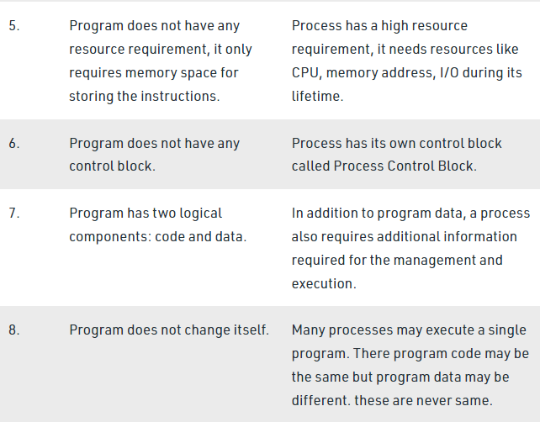
Difference between Program and Process

Slide 3
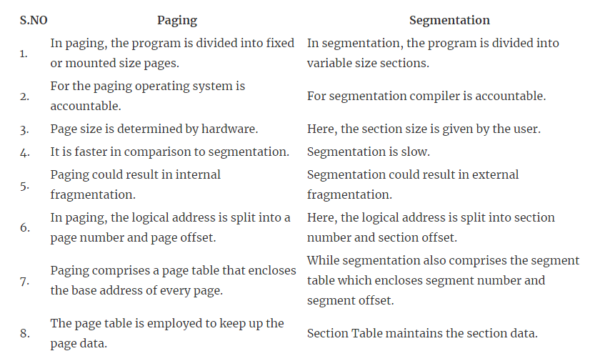
Difference Between Paging and Segmentation

Slide 4
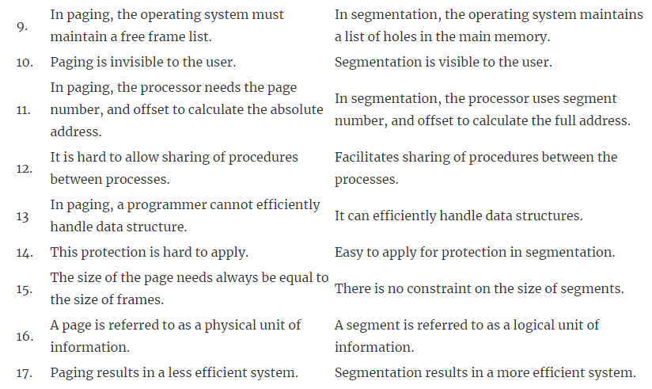
Difference Between Paging and Segmentation

Slide 5
End of Chapter 8

